Slide 1

An Investigation of High School and College Drafted Players Value in the MLB
By Micheas Yimam

Slide 2
Scope
Looking at 2004-2012 Draft Class
ANOVA testing with Population Breakdowns
Which Players preform better College or Highschool Draftees
What teams draft the most productive Players
What drafted position leads to the most productive players

Slide 3
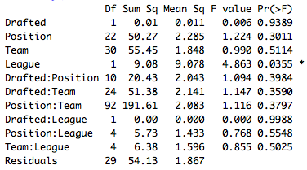
Why Anova?
PR(>F) – When less than .05 we know that the grouping affects the probability of the outcome.
Drafted: College or High School
Position: Drafted Position
Team: Drafted Team
League: Drafted Team’s League

Slide 4
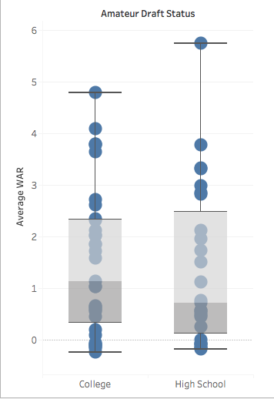

Who Preforms better?
WAR Range | Status | High School | College
Below 0 | Sent Down | 17(21.52%) | 22(15.71%)
2 > WAR > 0 | Replacable | 45(56.96%) | 84(60.00%)
3.5 > WAR > 2.01 | Starter | 7(8.86%) | 22(15.71%)
5.0 > WAR > 3.51 | Above Average | 8(10.13%) | 10(7.14%)
WAR >5.1 | All-Star | 2(2.53%) | 2(1.43%)
 | TOTAL: | 79 | 140

Slide 5
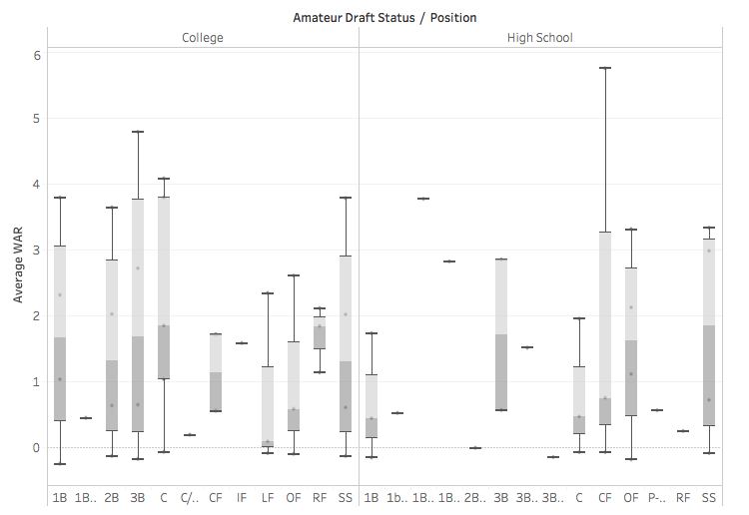


What Drafted positions preform the best?
High School | C | 1B | 2B | 3B | SS | LF | CF | OF | RF | 2B/SS | 1B/OF | 1B/P | 3B/P | 1B/P
Sent Down | 4 | 2 | 0 | 0 | 5 | 0 | 2 | 2 | 0 | 1 | 0 | 0 | 1 | 0
Replacable | 10 | 3 | 0 | 8 | 9 | 0 | 1 | 10 | 2 | 0 | 0 | 0 | 0 | 0
Starter | 1 | 2 | 0 | 0 | 1 | 0 | 0 | 2 | 0 | 0 | 0 | 0 | 0 | 0
Above Average | 0 | 0 | 0 | 0 | 1 | 0 | 0 | 4 | 0 | 0 | 1 | 2 | 0 | 2
All-Star | 0 | 0 | 0 | 1 | 0 | 0 | 1 | 0 | 0 | 0 | 0 | 0 | 0 | 0
College | C | 1B | 2B | 3B | SS | LF | CF | OF | RF | 2B/SS | 1B/OF | 1B/P | 3B/P | 1B/P
Sent Down | 6 | 1 | 4 | 3 | 5 | 1 | 0 | 2 | 0 | 0 | 0 | 0 | 0 | 0
Replaceable | 11 | 5 | 9 | 11 | 16 | 1 | 11 | 15 | 2 | 0 | 0 | 2 | 0 | 2
Starter | 2 | 1 | 1 | 5 | 2 | 1 | 5 | 3 | 1 | 0 | 0 | 0 | 0 | 0
Above Average | 1 | 0 | 2 | 2 | 4 | 0 | 0 | 0 | 1 | 0 | 0 | 0 | 0 | 0
All-Star | 1 | 1 | 0 | 0 | 0 | 0 | 0 | 0 | 0 | 0 | 0 | 0 | 0 | 0

Slide 6
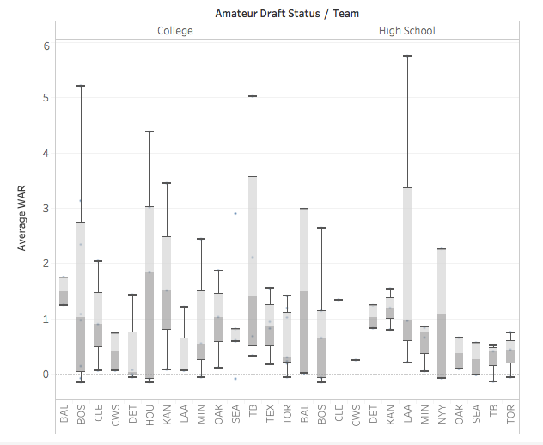

What teams draft the best? (American League)
Teams | BAL | BOS | NYY | TB | TOR | CLE | DET | MIN | KCN | CWS | LAA | OAK | HOU | TEX | SEA
High School | 2 | 5 | 2 | 3 | 3 | 1 | 3 | 5 | 0 | 1 | 3 | 2 | 0 | 0 | 2
Sent Down | 0 | 2 | 1 | 1 | 1 | 0 | 0 | 0 | 0 | 0 | 0 | 0 | 0 | 0 | 1
Replacable | 1 | 2 | 0 | 2 | 2 | 1 | 3 | 5 | 0 | 1 | 2 | 2 | 0 | 0 | 1
Starter | 0 | 0 | 1 | 0 | 0 | 0 | 0 | 0 | 0 | 0 | 0 | 0 | 0 | 0 | 0
Above Average | 1 | 1 | 0 | 0 | 0 | 0 | 0 | 0 | 0 | 0 | 0 | 0 | 0 | 0 | 0
All-Star | 0 | 0 | 0 | 0 | 0 | 0 | 0 | 0 | 0 | 0 | 1 | 0 | 0 | 0 | 0
College | 2 | 8 | 0 | 4 | 8 | 4 | 4 | 3 | 0 | 3 | 3 | 3 | 5 | 6 | 7
Sent Down | 0 | 2 | 0 | 0 | 1 | 0 | 2 | 1 | 0 | 0 | 0 | 0 | 2 | 0 | 3
Replacable | 2 | 3 | 0 | 2 | 6 | 2 | 2 | 1 | 0 | 3 | 3 | 3 | 0 | 6 | 3
Starter | 0 | 2 | 0 | 0 | 1 | 2 | 0 | 0 | 0 | 0 | 0 | 0 | 2 | 0 | 0
Above Average | 0 | 1 | 0 | 2 | 0 | 0 | 0 | 1 | 0 | 0 | 0 | 0 | 1 | 0 | 1
All-Star | 0 | 0 | 0 | 0 | 0 | 0 | 0 | 0 | 0 | 0 | 0 | 0 | 0 | 0 | 0

Slide 7
ANOVA Results
No indication of team having an impact.
And neither did any combination.
League has an impact?

Slide 8
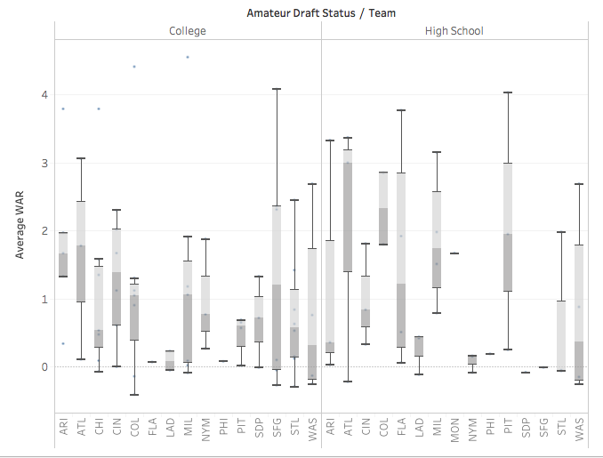
What teams draft the best? (National League)
Teams | WAS | ATL | NYM | MIA | PHI | CIN | PIT | STL | CHI | MIL | LAD | ARI | COL | SDP | SFG
High School | 4 | 3 | 4 | 0 | 2 | 3 | 3 | 3 | 0 | 4 | 5 | 3 | 2 | 1 | 1
Sent Down | 2 | 1 | 2 | 0 | 0 | 0 | 0 | 2 | 0 | 0 | 2 | 0 | 0 | 1 | 1
Replacable | 1 | 0 | 2 | 0 | 2 | 3 | 1 | 1 | 0 | 1 | 3 | 2 | 1 | 0 | 0
Starter | 0 | 0 | 0 | 0 | 0 | 0 | 1 | 0 | 0 | 2 | 0 | 1 | 0 | 0 | 0
Above Average | 1 | 2 | 0 | 0 | 0 | 0 | 1 | 0 | 0 | 1 | 0 | 0 | 0 | 0 | 0
All-Star | 0 | 0 | 0 | 0 | 0 | 0 | 0 | 0 | 0 | 0 | 0 | 0 | 1 | 0 | 0
College | 5 | 3 | 3 | 0 | 1 | 7 | 4 | 8 | 9 | 7 | 2 | 6 | 9 | 5 | 6
Sent Down | 2 | 0 | 0 | 0 | 0 | 0 | 0 | 1 | 1 | 1 | 1 | 0 | 2 | 1 | 2
Replacable | 1 | 1 | 3 | 0 | 1 | 4 | 4 | 6 | 6 | 4 | 1 | 3 | 5 | 4 | 1
Starter | 2 | 1 | 0 | 0 | 0 | 3 | 0 | 1 | 1 | 1 | 0 | 2 | 1 | 0 | 2
Above Average | 0 | 1 | 0 | 0 | 0 | 0 | 0 | 0 | 0 | 1 | 0 | 0 | 1 | 0 | 1
All-Star | 0 | 0 | 0 | 0 | 0 | 0 | 0 | 0 | 1 | 0 | 0 | 1 | 0 | 0 | 0

Slide 9
In conclusion
What I can conclude with my analysis
College or High School Impact: No
Drafted Position: No
Drafted Team: No
Drafted League: Maybe
Thank you for being a great Audience, and I cant wait to do more baseball research
Sources
https://www.baseball-reference.com/
http://www.thebaseballcube.com/draft/

